Slide 1



Linear Algebra For Machine Learning

Slide 2
Agenda
01
What is a Matrix?
02
5 | 2 | 9
4 | 6 | 7
1 | 3 | 8
Matrix Operations
Number of Rows
03
Eigen Values
04
Eigen Vectors

Slide 3
What is a Matrix?

Slide 4
What is a Matrix?
A Matrix is a combination of arrays, numbers or expressions that are represented in a rectangular format in the form of rows and columns.
Number of Columns
5 | 2 | 9
4 | 6 | 7
1 | 3 | 8
Number of Rows

Slide 5
What is a Matrix?
Number of Columns(n)
The rows and columns of a matrix are associated with the dimensions of a matrix and immensely help while working with linear expressions. The matrix with m rows and n columns will have the m x n dimensions.
5 | 2 | 9
4 | 6 | 7
1 | 3 | 8
Number of Rows(m)

Slide 6
What is a Matrix?
Number of Columns(n)
Let us go through some of the Matrix operations like addition, subtraction, multiplication, transpose, inverse of a matrix, etc.
5 | 2 | 9
4 | 6 | 7
1 | 3 | 8
Number of Rows(m)

Slide 7
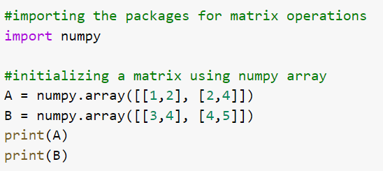
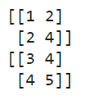
Hands on - Python
Output
In Python, we use the list of lists in a numpy array to declare a list. As seen in the example we have declared A and B matrices with dimensions 2x2.

Slide 8
Matrix Operations

Slide 9
Addition
5 | 2 | 2
4 | 6 | 7
1 | 3 | 2
4 | 5 | 4
2 | 3 | 2
1 | 2 | 4
9 | 7 | 6
6 | 9 | 9
2 | 5 | 6
In the addition operation, the corresponding values of the elements are added to the resultant matrix like shown in the example.

Slide 10
Addition
5 | 2 | 2
4 | 6 | 7
1 | 3 | 2
4 | 5 | 4
2 | 3 | 2
1 | 2 | 4
9 | 7 | 6
6 | 9 | 9
2 | 5 | 6
In the addition operation, it is mandatory that the dimensions of the matrices are equivalent to each other.

Slide 11
Subtraction
5 | 2 | 2
4 | 6 | 7
1 | 3 | 2
4 | 5 | 4
2 | 3 | 2
1 | 2 | 4
1 | -3 | -2
2 | 3 | 5
0 | 1 | -2
Similar to the addition operation, in subtraction we will subtract the corresponding element in both the matrices to get the resultant matrix.

Slide 12
Subtraction
5 | 2 | 2
4 | 6 | 7
1 | 3 | 2
4 | 5 | 4
2 | 3 | 2
1 | 2 | 4
1 | -3 | -2
2 | 3 | 5
0 | 1 | -2
In the subtraction operation, it is mandatory for the matrices to be of equivalent dimensions as well.

Slide 13
Multiplication
5 | 2 | 9
4 | 6 | 7
1 | 3 | 8
10 | 4 | 18
8 | 12 | 14
2 | 6 | 16
2
Multiplying a matrix with a scalar will yield the resultant matrix that will have each element multiplied with the scalar.

Slide 14
Vector Multiplication
While multiplying a matrix with a column vector, we must figure out the dimensions of the resultant matrix. For this, the rows of the first matrix and the columns of the second matrix will be the dimensions of the resultant matrix.
5 | 2 | 9
4 | 6 | 7
1 | 3 | 8
1
2
4

Slide 15
Vector Multiplication
The dimensions of the first matrix is 3x3 and that of the second matrix is 3x1. Therefore, the dimensions of the resultant matrix will be 3x1.
5 | 2 | 9
4 | 6 | 7
1 | 3 | 8
1
2
4

Slide 16
Vector Multiplication
5 | 2 | 9
4 | 6 | 7
1 | 3 | 8
1
2
4
X
Y
Z
For finding the elements of the resultant matrix, we multiply the rows of the first matrix to the column of the second matrix.

Slide 17
Vector Multiplication
5 | 2 | 9
4 | 6 | 7
1 | 3 | 8
1
2
4
45
44
39
X = (5x1) + (2x2) + (9x4) = 5+4+36 = 45
Y = (4x1) + (6x2) + (7x4) = 4+12+28 = 44
Z = (1x1) + (3x2) + (8x4) = 1+6+32 = 39

Slide 18
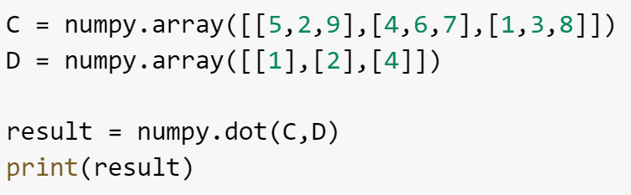
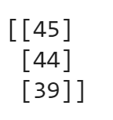
Hands on - Python
Output
In this example, we have used the numpy.dot() method to multiply the two matrices.

Slide 19
Matrix Multiplication
Similar to the vector multiplication, we will determine the dimension of the resultant matrix from these two matrices.
5 | 2 | 9
4 | 6 | 7
1 | 3 | 8
1 | 2
2 | 1
1 | 2

Slide 20
Matrix Multiplication
The dimension of the first matrix is 3x3 and that of the second matrix is 3x2. Therefore the dimension of the resultant matrix will be 3x2.
5 | 2 | 9
4 | 6 | 7
1 | 3 | 8
1 | 2
2 | 1
1 | 2

Slide 21
Matrix Multiplication
5 | 2 | 9
4 | 6 | 7
1 | 3 | 8
1 | 2
2 | 1
1 | 2
x1 | x2
y1 | y2
z1 | z2

Slide 22
Matrix Multiplication
X1 = (5x1) + (2x2) + (9x1) = 5+4+9 = 18
X2 = (5x2) + (2x1) + (9x2) = 10+2+18 = 30
5 | 2 | 9
4 | 6 | 7
1 | 3 | 8
1 | 2
2 | 1
1 | 2
X1 = (4x1) + (6x2) + (7x1) = 4+12+7 = 23
X2 = (4x2) + (6x1) + (7x2) = 8+6+14 = 28
X1 = (1x1) + (3x2) + (8x1) = 1+6+8 = 15
X2 = (1x2) + (3x1) + (8x2) = 2+3+16 = 21

Slide 23
Matrix Multiplication
5 | 2 | 9
4 | 6 | 7
1 | 3 | 8
1 | 2
2 | 1
1 | 2
18 | 30
23 | 28
15 | 21
There is a limitation with matrix multiplication that states that the columns of the first matrix should always be equal to the rows of the second matrix. For example – if the dimensions of the above matrices were 3x3 and 2x2, the multiplication would not have been possible.

Slide 24
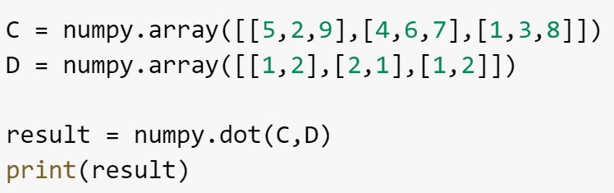
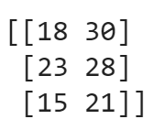
Hands on - Python
Output
In this example, we have used the numpy.dot() method to multiply the two matrices.

Slide 25
Matrix Multiplication
The dimension of the first matrix is 3x3 and that of the vector is 3x3. Therefore, the dimension of the resultant matrix will be 3x3.
5 | 2 | 9
4 | 6 | 7
1 | 3 | 8
5 | 2 | 9
4 | 6 | 7
1 | 3 | 8

Slide 26
Matrix Multiplication
The approach would be same here, we will multiply the rows of the first matrix to the column of the second matrix.
5 | 2 | 9
4 | 6 | 7
1 | 3 | 8
1 | 2 | 1
3 | 1 | 2
4 | 2 | 1

Slide 27
Matrix Multiplication
5 | 2 | 9
4 | 6 | 7
1 | 3 | 8
1 | 2 | 1
3 | 1 | 2
4 | 2 | 1
47 | 30
X1 = (5x1) + (2x3) + (9x4) = 5+6+36 = 47
X2 = (5x2) + (2x1) + (9x2) = 10+2+18 = 30

Slide 28
Matrix Multiplication
5 | 2 | 9
4 | 6 | 7
1 | 3 | 8
1 | 2 | 1
3 | 1 | 2
4 | 2 | 1
47 | 30 | ?
? | ? | ?
? | ? | ?
Similarly, you can find the rest of the elements of the resultant matrix.

Slide 29
Matrix Multiplication
5 | 2 | 9
4 | 6 | 7
1 | 3 | 8
1 | 2 | 1
3 | 1 | 2
4 | 2 | 1
47 | 30 | 18
50 | 28 | 23
42 | 21 | 15

Slide 30
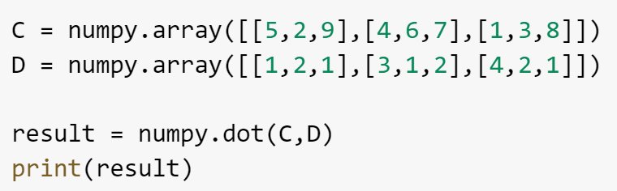
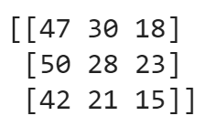
Hands on - Python
Output
In this example, we have used the numpy.dot() method to multiply the two matrices.

Slide 31
Cross Product
3
2
8
2
9
7
i | j | k
3 | 2 | 8
2 | 9 | 7
i
2 | 8
9 | 7
j
3 | 8
2 | 7
k
3 | 2
2 | 9

Slide 32
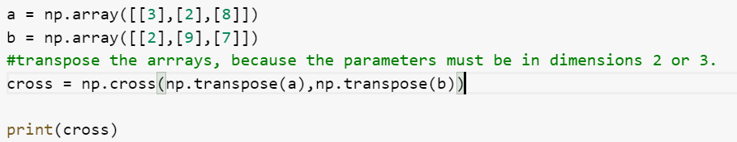

Hands on - Python
Output
In this example, we have used the numpy.cross() method to find the cross product of the two matrices.

Slide 33
Transpose
T
1 | 2
1 | 1
0 | 2
1 | 1 | 0
2 | 1 | 2
In the transpose of a matrix, the columns and rows are interchanged like shown in the example.

Slide 34
Properties of Transpose of a Matrix
Transpose of a Transposed matrix is the original matrix
(A’)’ = A
Additive property of transpose of a matrix
(A+B)’ = A’ + B’
Multiplication by a Constant
K x A’ = KA’, Where K is a constant
Multiplication property of the transpose:
(AB)’ = B’A’

Slide 35
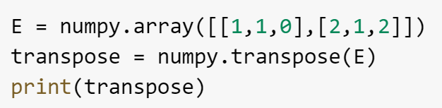
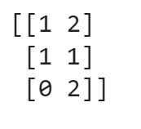
Hands on - Python
Output
In this example, we have used the numpy.transpose() method to obtain the transpose of the matrix E.

Slide 36
Inverse
-1
5 | 2 | 9
4 | 6 | 7
1 | 3 | 8
To understand the inverse of a matrix, there are several concepts that you must be familiar with like determinant of a matrix, adjoint of a matrix, etc.

Slide 37
Inverse – Determinant of a Matrix
5 | 2 | 9
4 | 6 | 7
1 | 3 | 8
We can follow the laplacian expansion method to find the determinant of the matrix. It helps us in finding the inverse of the matrix.

Slide 38
Inverse – Determinant of a 2x2 Matrix
a | b
c | d
|Matrix| = a x d – b x c
1 | 4
6 | 9
|Matrix| = 1 x 9 – 4 x 6 = 9 – 24 = -15

Slide 39
Inverse – Determinant of a 3x3 Matrix
a | b | c
d | e | f
g | h | i
|Matrix| = a(e x i – f x h) – b(d x i – f x g) + c(d x h – e x g)
2 | 2 | -3
1 | 2 | 2
1 | 1 | 2
|Matrix| = 2(2 x 2 – 2 x 1) – 2(1 x 2 – 2 x 1) – 3(1 x 1 – 2 x 1)
= 2(2) – 2(0) – 3(-1)
= 4 – 0 – (-3)
= 4 + 3 = 7

Slide 40
Inverse – Adjoint of a Matrix
5 | 2 | 9
4 | 6 | 7
1 | 3 | 8
To find the adjoint of a given matrix, we have to find the transpose of the cofactors of the elements in the given matrix. It is also known as adjugate of a matrix.

Slide 41
Inverse – Adjoint of a Matrix
5 | 2 | 9
4 | 6 | 7
1 | 3 | 8
m11 | m12 | m13
m21 | m22 | m23
m31 | m32 | m33
The minor (m11, m12,… mij) are the determinants of the square matrix that is formed after eliminating the i^{th} row and j^{th} column of the matrix. We use the minors to calculate the cofactors of the given matrix.

Slide 42
Inverse – Adjoint of a Matrix
5 | 2 | 9
4 | 6 | 7
1 | 3 | 8
m11 | m12 | m13
m21 | m22 | m23
m31 | m32 | m33
Formulae to find the cofactors = Cij = (-1)^{i+j}|mij|
We will use the above formulae to calculate the cofactors of the given matrix.

Slide 43
Inverse – Adjoint of a Matrix
m11 = 48 – 21 = 27
m22 = 40 – 9 = 31
m12 = 32 – 7 = 25
m23 = 15 -2 = 13
m13 = 12 – 6 = 6
m31 = 14 – 54 = -40
m21 = 16 – 27 = -11
m32 = 35 – 36 = -1
m33 = 30 – 8 = 22

Slide 44
Inverse – Adjoint of a Matrix
T
27 | -25 | 6
11 | 31 | -13
-40 | 1 | 22
27 | 11 | -40
-25 | 31 | 1
6 | -13 | 22
Let’s take a look at the formulae to find the inverse of the matrix.

Slide 45
Inverse – Formulae
-1
The formulae to calculate the inverse of a matrix is as follows:
A⁻¹ = 1/|A|. Adj A
2 | 1
4 | 3

Slide 46
Inverse – Formulae
-1
Now, to calculate the inverse, we will find the determinant and adjoint of the given matrix.
2 | 1
4 | 3

Slide 47
Inverse – Formulae
Adjoint of the given matrix is
3 | -1
-4 | 2
Determinant of the given matrix is
=> 2x3 – 4x1 = 2

Slide 48
Inverse – Formulae
-1
2 | 1
4 | 3
3/2 | -1/2
-2 | 1
To verify the result we can use the inverse property that states that:
AA⁻¹ = I , where I is the identity matrix.

Slide 49
Inverse – Formulae
2 | 1
4 | 3
3/2 | -1/2
-2 | 1
1 | 0
0 | 1
Since we are getting an identity matrix when we did AA⁻¹, we have calculated the inverse of the matrix successfully. We can follow the same formulae for the 3x3 matrix as well – where the adjoint and the determinant will determine the inverse of the given matrix.

Slide 50
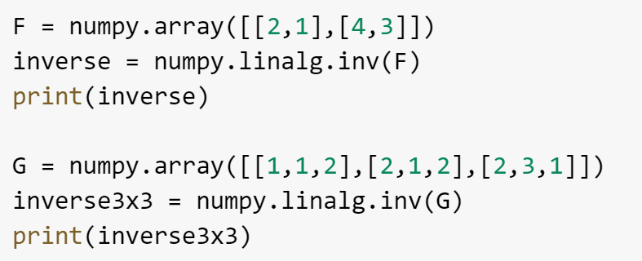
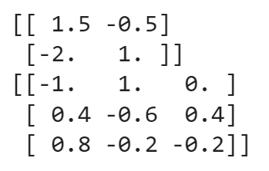
Hands on - Python
Output
In this example, we have used the numpy.linalg.inv() method to calculate the inverse of a 2x2 and a 3x3 matrices F and G respectively.

Slide 51
Rank of a Matrix
The number of linearly independent columns in a matrix is known as the rank of the matrix. There are several ways we can use to calculate the rank of the matrix. One such method is to reduce the matrix to its row-echelon form.
1 | 0 | 0
0 | 1 | 0
0 | 0 | 1
ρ(A)

Slide 52
Rank of a Matrix
Things to Remember:
If the matrix A is of the order mxm, and if the determinant of |A| is not equal to zero, then the rank of the matrix will be m.
If the determinant is equal to zero, the rank will be less than m.
1 | 0 | 0
0 | 1 | 0
0 | 0 | 1

Slide 53
Rank of a Matrix
Row Echelon Form
The pivots go from top-left to bottom right. Pivots are the first non-zero element in the row.
There must be a zero below the pivots in the row echelon form.
The rows will all zero elements must be at the end of the matrix.
1 | 0 | 0
0 | 1 | 0
0 | 0 | 1

Slide 54
Rank of a Matrix
1 | 2 | 2
0 | 1 | 4
2 | 4 | 4
1 | 2 | 2
0 | 1 | 4
0 | 0 | 0
We can use the gaussian elimination method where we interchange, multiply and add the rows to reach the row echelon form. Here, we have used the following operation to get the row echolen form.
R3 = R3 – 2R1
Since, the non-zero rows are 2, hence the rank of the matrix is 2.

Slide 55
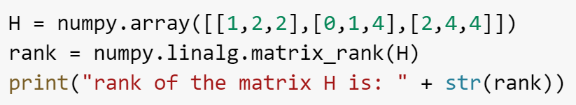

Hands on - Python
Output
In this example, we have used the numpy.linalg.matrix_rank() method to calculate the rank of the given matrix.

Slide 56
Eigen Values And Eigen Vectors

Slide 57

Characteristic Polynomial
A characteristic polynomial is used to derive the Eigen values of a given matrix. The characteristic polynomial of a matrix A is denoted by the function given below.
The characteristic polynomial of the square matrix A is given by the function f(λ), and the I is the identity matrix. The whole objective of using the characteristic polynomial is to find the Eigen values of the given matrix.

Slide 58
Eigen Value
Eigen values are the roots of the characteristic polynomial of the matrix A. Let’s understand this with a simple example.
2 | 1
4 | 3
To calculate the Eigen values of the given matrix, we will first compute the characteristic polynomial and then derive the Eigen values by finding the roots of the Characteristic polynomial.

Slide 59
Eigen Value
To find the characteristic polynomial, we will calculate the determinant of (A - λI_{n} ).
The computation will get the resultant characteristic polynomial as:
f(λ ) = λ² - 6 λ +1
5 | 2
2 | 1
Now, to find the eigen values, we will calculate the roots of the characteristic polynomial.

Slide 60
Eigen Values
f(λ ) = λ² - 6 λ +1
-> λ² - 6 λ +1 = 0
Using the quadratic formula, we can get the roots of the equation as 3 + 2√2 and 3 - 2√2.
5 | 2
2 | 1
Therefore, the Eigen values for the given matrix are 3 + 2√2 and 3 - 2√2

Slide 61
Eigen Vectors
Now to calculate the Eigen vectors, we will do the following:
1. We will use the equation, Av = λv where v is the eigen vector.
5 | 2
2 | 1
5 | 2
2 | 1
X
Y
X
Y
λ .

Slide 62
Eigen Vectors
5 | 2
2 | 1
X
Y
X
Y
λ .
Using the equations that we get by solving the above equation for both the values of λ, we will get the Eigen Vectors of the given matrix.

Slide 63
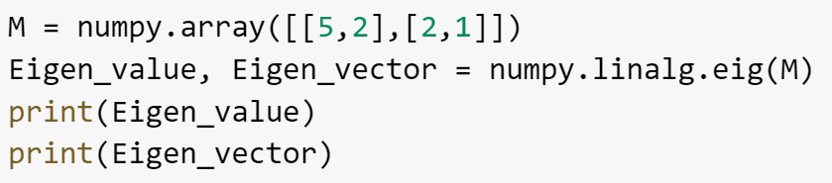
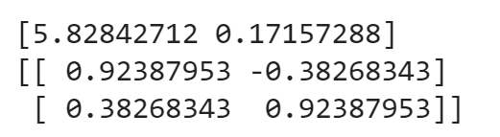
Hands on - Python
Output
In this example, we have used the numpy.linalg.eig() method to calculate the eigen values and eigen vectors of the given matrix M.

Slide 64
Correlation Matrix
Collinearity is a concept in statistics that resonates with the linear relationship between the predictor variables(independent variable) in a regression model. If the independent variables are correlated, they won’t be able to independently predict the value of the dependent variable in the regression model.
A correlation matrix is a table that has the correlated coefficients between the variables. It is mostly used to deduce the patterns in a large dataset.

Slide 65
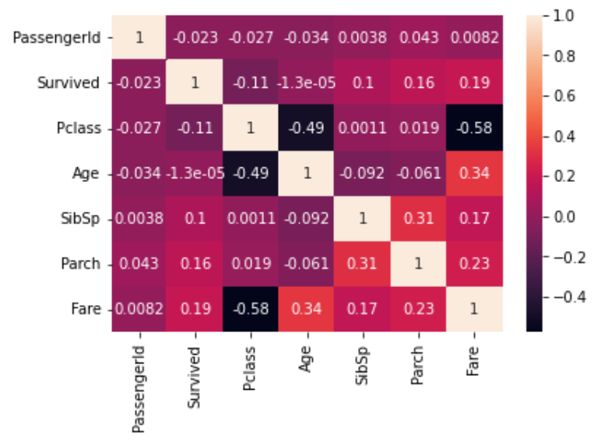
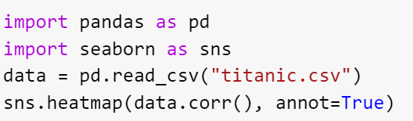
Hands on - Python
In this example, we have plotted the correlation coefficients of the titanic data on a heatmap using seaborn in python. By the value of the correlation coefficient, we can figure out the collinearity of the predictor variables.

Slide 66

India: +91-7847955955
US: 1-800-216-8930 (TOLL FREE)
support@intellipaat.com
24/7 Chat with Our Course Advisor
Notes:
Thank you!

